Slide 1
Medimatch: AI-Assisted Donor-Recipient Compatibility and Matching Portal
CAPSTONE PROJECT
PRESENTED BY :
Student Name - Manmeet Kaur
College Name – Sri Guru Nanak Dev Khalsa College, University of Delhi
Department – B.Sc. Mathematics
4. AICTE ID - STU6a68f444c37e21785263172

Slide 2
OUTLINE
Problem Statement
Proposed System/Solution
System Development Approach
Algorithm & Deployment
Result
Conclusion
Future Scope
References

Slide 3
Problem Statement
Healthcare institutions frequently face challenges in connecting blood and organ donors with recipients during emergencies. Traditional donor search methods rely on manual records, personal contacts, hospital databases, and social media outreach, which often result in delays and missed opportunities. The absence of a centralized platform makes it difficult to identify compatible donors quickly based on blood group, organ type, availability, and location. In critical situations, these delays can significantly impact patient survival rates.
Therefore, there is a need for an intelligent digital platform that can efficiently register donors and recipients, maintain donor records, and provide rapid donor-recipient matching to support timely medical intervention.

Slide 4
Proposed Solution
MediMatch is a web-based Blood and Organ Donor–Recipient Matching System designed
to streamline the process of donor registration, recipient requests, and compatibility matching.
The system provides:
Donor registration and profile management.
Recipient request submission.
Automated donor-recipient matching based on compatibility criteria.
Real-time dashboard for managing records.
AI-powered assistance for donation-related information.
Centralized database for storing donor and recipient information.
User-friendly interface accessible through any modern web browser.
The platform aims to reduce response time during medical emergencies and improve
the efficiency of donor allocation. Similar modern matching systems use compatibility,
availability, and location-based ranking to accelerate emergency response.

Slide 5
System Approach
1. System Requirements
The development of the MediMatch system requires both hardware and software resources to ensure smooth operation and efficient donor-recipient matching.
Hardware Requirements
Processor: Intel Core i3 or above
RAM: Minimum 4 GB (8 GB recommended)
Storage: Minimum 500 MB free space
Internet Connection: Required for deployment and cloud access
Software Requirements
Operating System: Windows 10/11, Linux, or macOS
Programming Language: Python 3.10+
Development Environment: VS Code / IBM Skills Network Lab / Jupyter Notebook
Database: SQLite
Version Control: Git and GitHub
Deployment Platform: Streamlit Community Cloud
Web Browser: Google Chrome, Microsoft Edge, Firefox

Slide 6
SYSTEM APPROACH
2. Libraries Required to Build the Model
Library | Purpose
Streamlit | Creating the web-based user interface
SQLite3 | Database creation and management
Pandas | Data handling and record management
NumPy | Numerical operations and calculations
Datetime | Managing date and time information
OS | File and system operations
Hashlib | Data security and password hashing (if implemented)
JSON | Data storage and transfer
Plotly / Matplotlib | Data visualization and dashboard analytics
Scikit-learn | Future AI/ML-based prediction and recommendation features
OpenAI / Generative AI APIs | AI Assistant module for user guidance

Slide 7
Algorithm & Deployment
Algorithm Selection
MediMatch uses a Rule-Based Matching Algorithm to identify compatible blood and organ donors. This approach was chosen because medical compatibility follows predefined rules and requires accurate, transparent matching.
Data Input
The algorithm uses:
Donor blood group
Organ type
Availability status
Recipient blood group
Required organ
Basic donor and recipient details

Slide 8
ALGORITHM & DEPLOYMENT
Matching Process
Retrieve donor and recipient records.
Filter available donors.
Check blood group compatibility.
Verify organ type compatibility.
Rank and display eligible donors.
Output
The system generates a list of compatible donors and displays the best matches through the Streamlit dashboard for quick decision-making during emergencies.

Slide 9
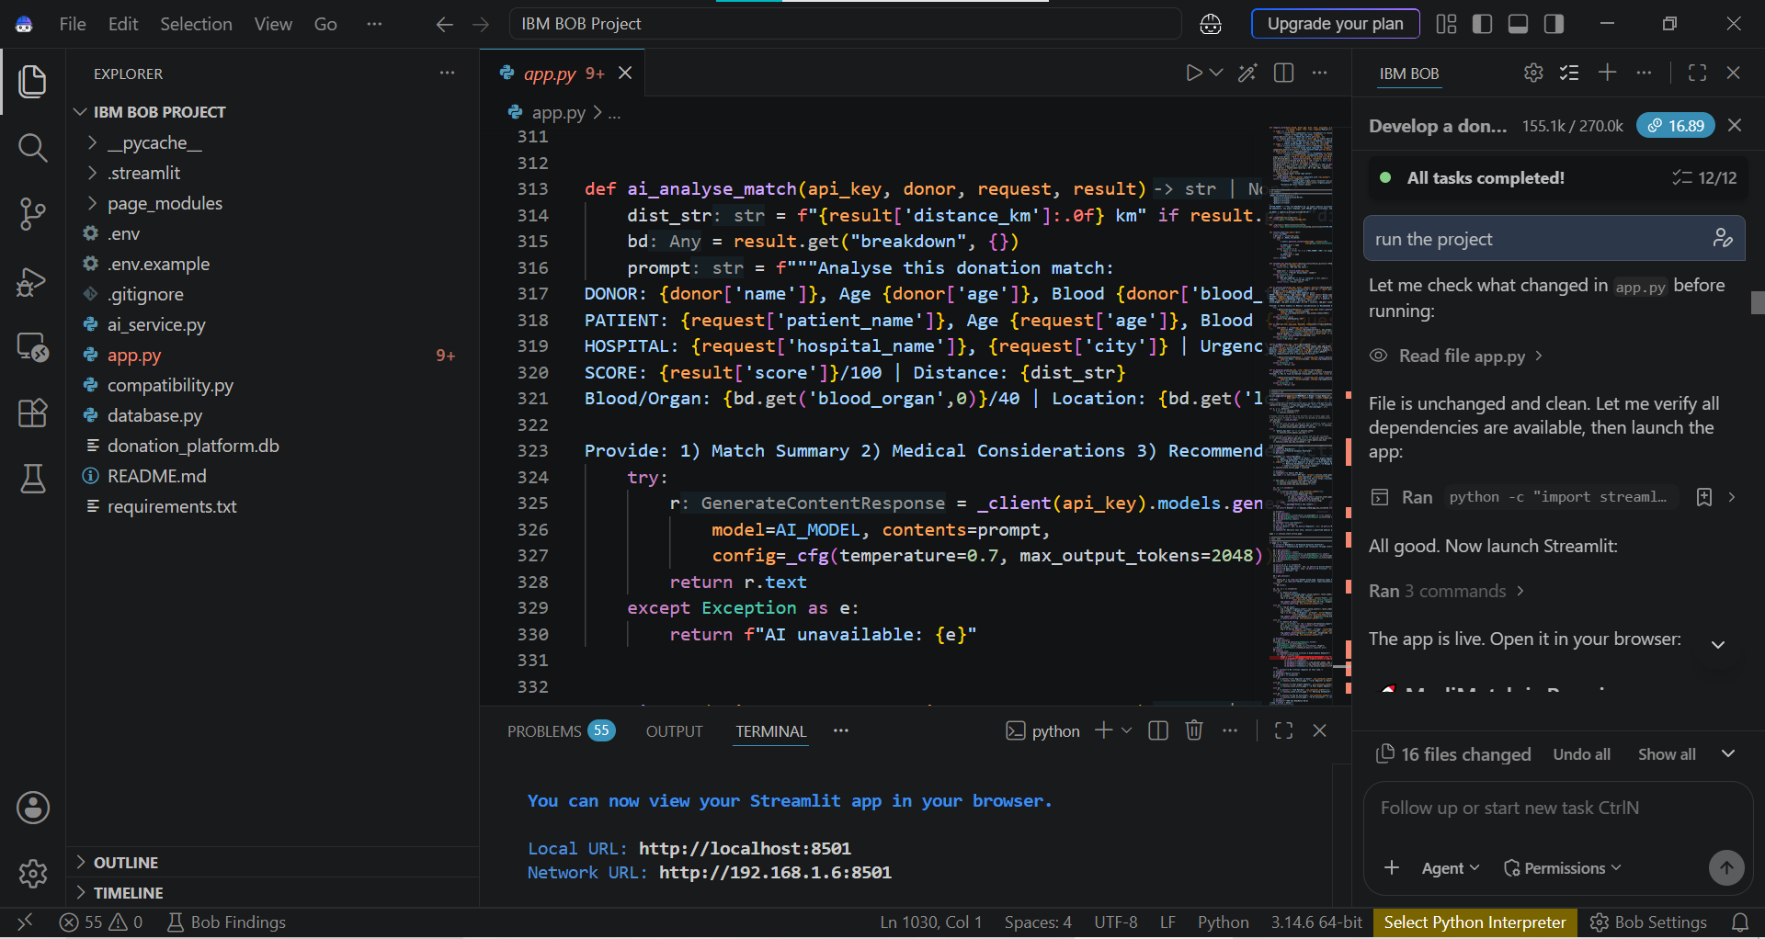
Result
IBM BOB Interface

Slide 10
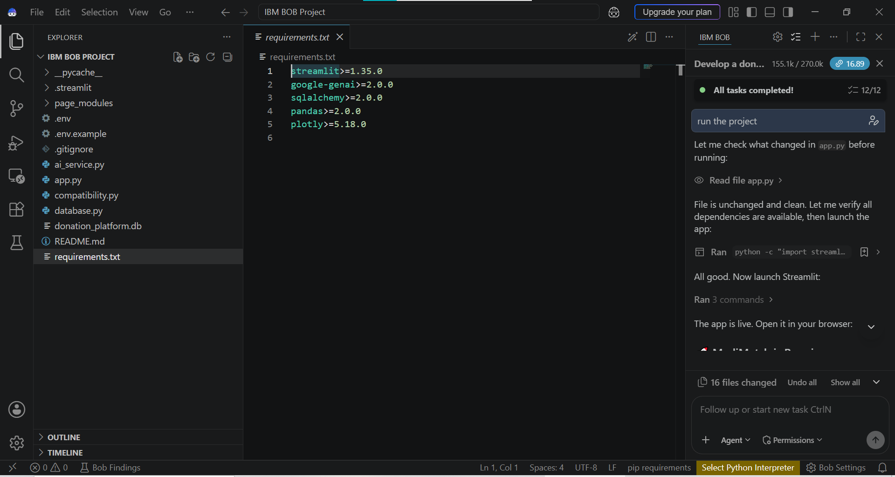
Result
Libraries used

Slide 11
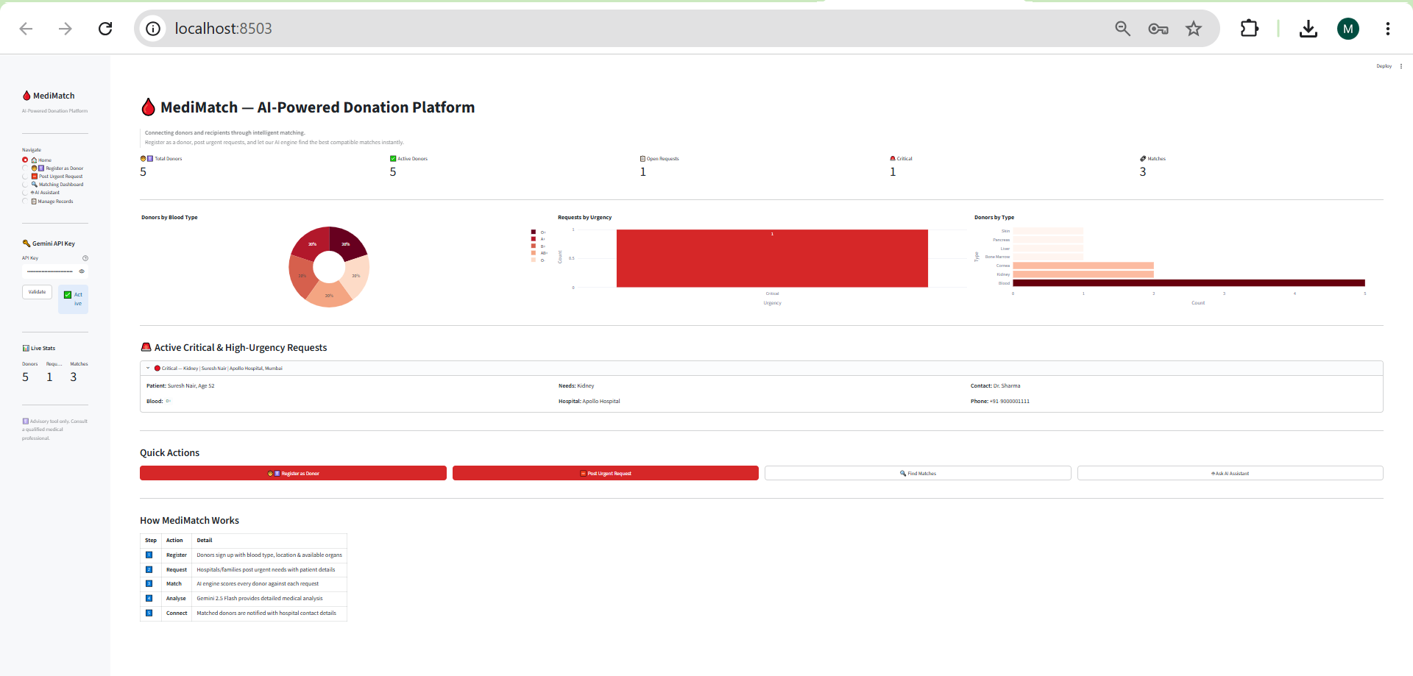
Result
OUTPUT - Main Interface of MediMatch

Slide 12
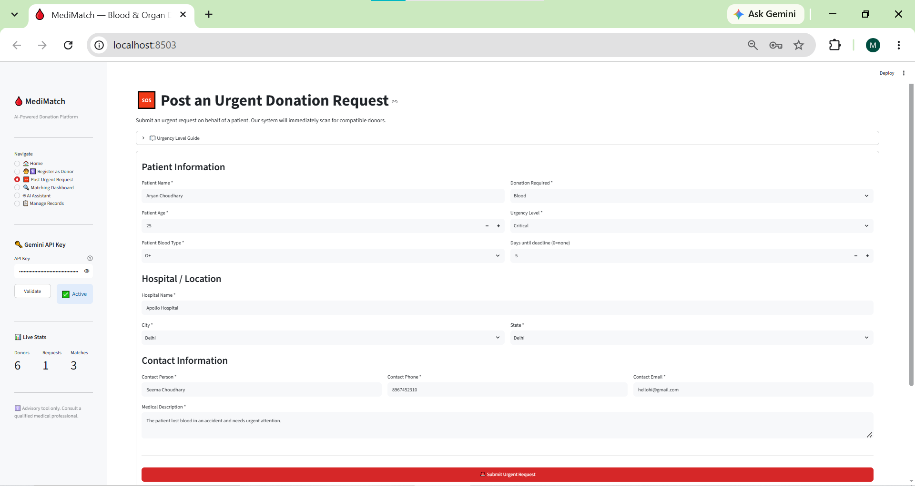
Result
INPUT – Making Donation Request

Slide 13
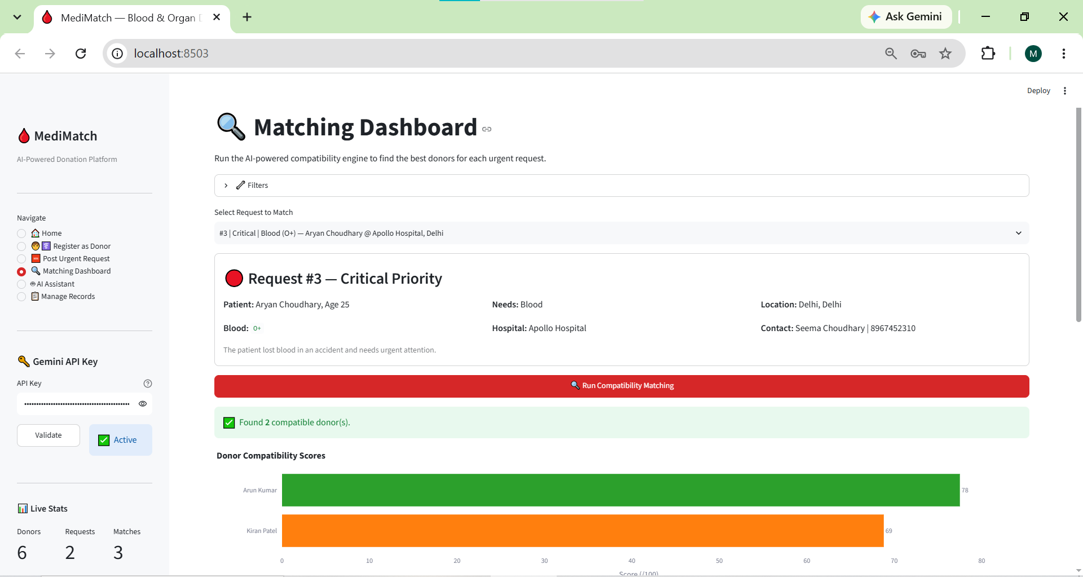
Result
OUTPUT – Finding Compatible Donors

Slide 14
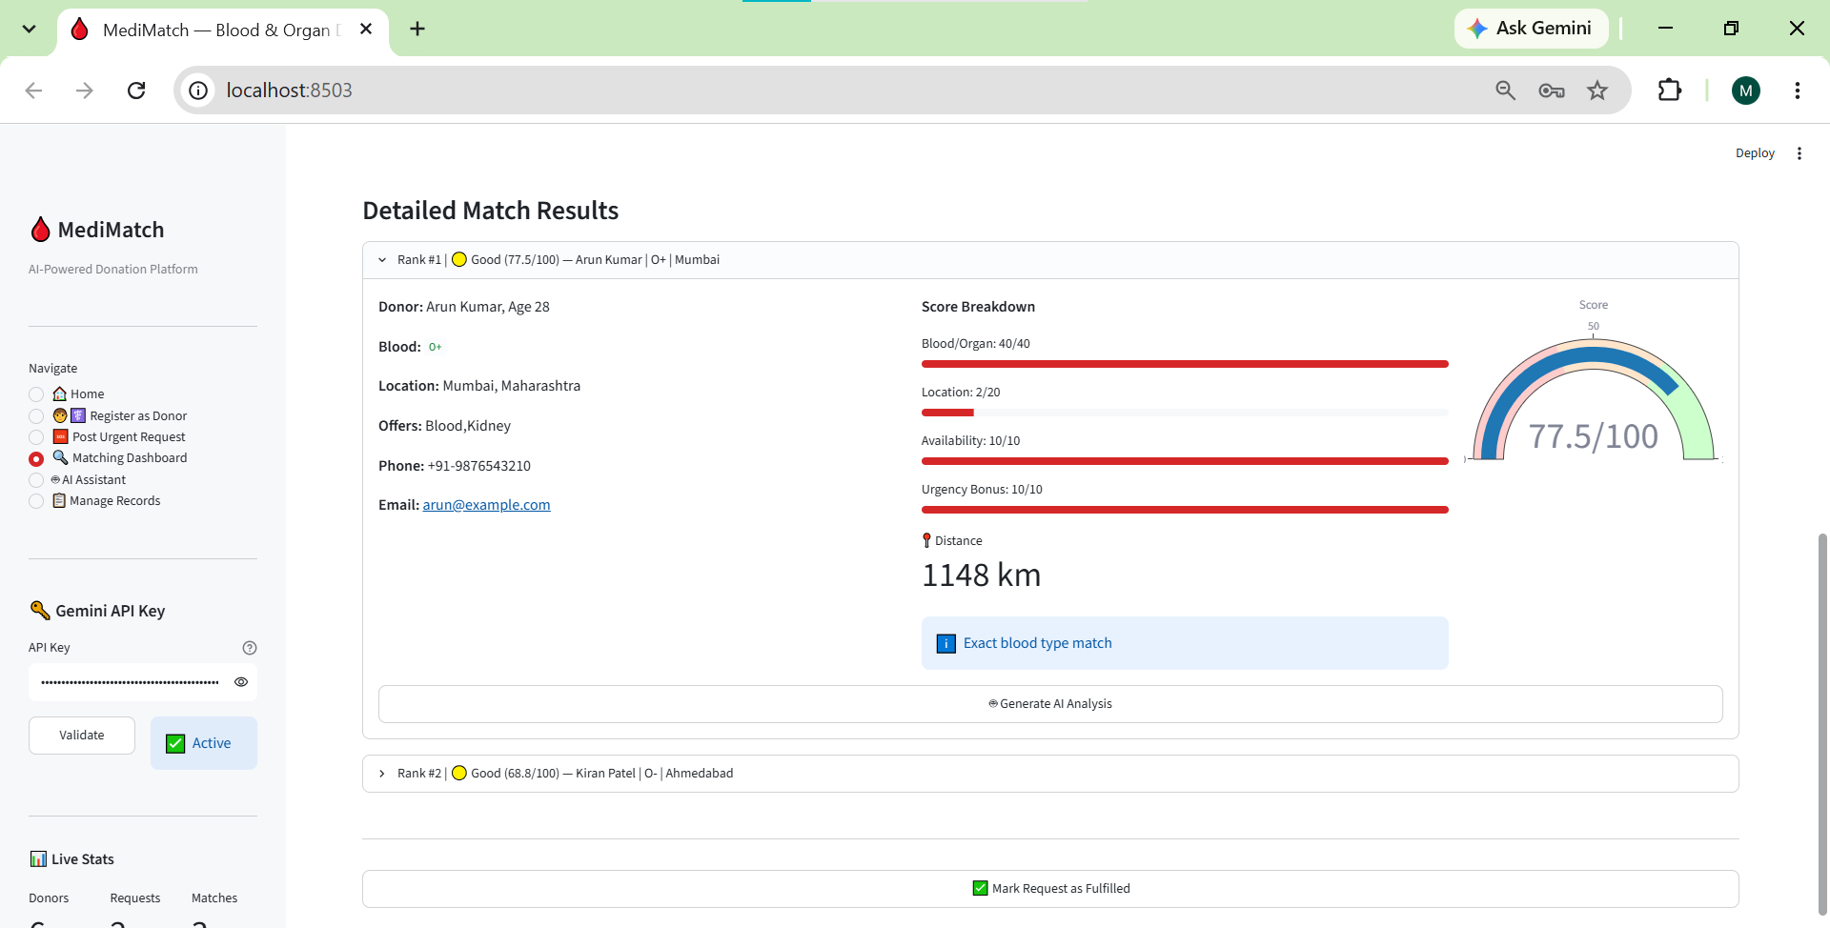
Result
OUTPUT – Successful Matching

Slide 15
Conclusion
MediMatch successfully demonstrates the application of modern web technologies in healthcare management. The system automates donor registration, recipient request handling, and compatibility matching, thereby reducing the time required to identify suitable donors. The integration of an AI assistant further enhances user support and awareness regarding blood and organ donation.
The project contributes toward improving healthcare accessibility and emergency response by providing a centralized platform that efficiently connects donors and recipients.

Slide 16
Future scope
The project can be extended through the following enhancements :
GPS-based nearest donor identification.
Real-time notifications through SMS and email.
Hospital and blood bank integration.
Mobile application development (Android/iOS).
Machine Learning-based donor availability prediction.
AI-powered priority ranking of recipients.
Integration with national healthcare databases.
Real-time analytics and visualization dashboards.
Multi-language support.
Block chain-based secure donor record management.
These enhancements can improve scalability, transparency, and reliability in large-scale healthcare environments.

Slide 17
References
Python Software Foundation. Python Documentation. Available at: https://www.python.org
Streamlit Documentation. Streamlit Web Application Framework. Available at: https://streamlit.io
SQLite Documentation. SQLite Database Engine. Available at: https://www.sqlite.org
McKinney, W. Python for Data Analysis. O'Reilly Media.
WHO (World Health Organization). Blood Safety and Availability. Available at: https://www.who.int
National Organ and Tissue Transplant Organization (NOTTO), Government of India.
Available at: https://www.notto.gov.in
Blood & Organ Donation Matcher – Real-Time Digital Platform Case Study.
Blood Donor–Recipient Matching System Report.
Organ Donation Matching System Research Studies.

Slide 18
Deployment link / github link
Github Link : https://github.com/meetukhurana07-bot/MediMatch_.git
Streamlit Link : https://medimatchgit-im64hbmmpshfcrfxo9u3ws.streamlit.app/

Slide 19
THANK YOU

